Slide 1
Start recording

Slide 2
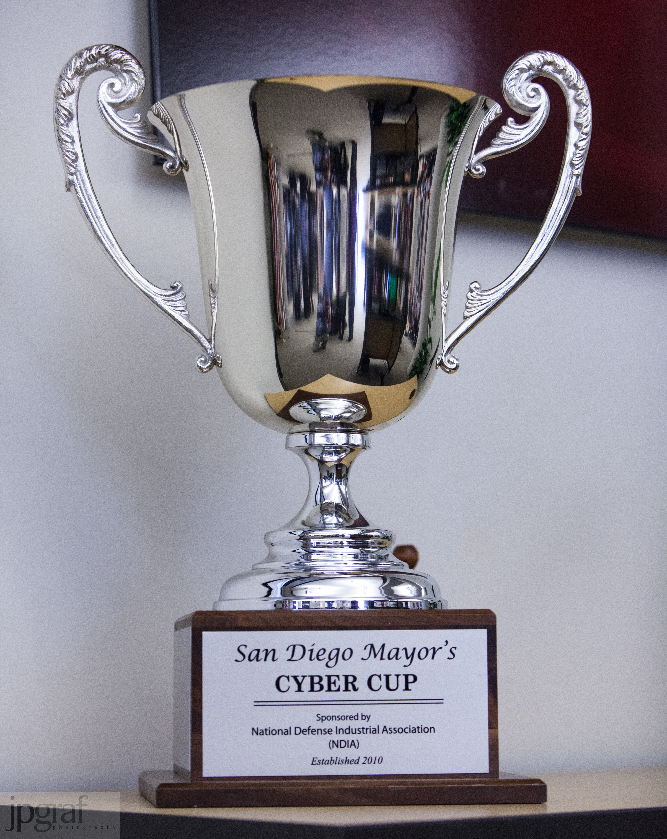
The San Diego Mayors’ Cyber Cup (SDMCC) Training session
INTRO TO THE COMPETITION – DECEMBER 7, 2015

Slide 3
Weekly training
Mon/Wed – 7pm via Go To training
14 Dec is 6pm
Approximately 1 hour
Registration required
Registration link sent by email and posted on Basecamp
Sessions will be recorded and available online

Slide 4
Agenda
Welcome & Introductions
Overview/key dates
Competition and Rules Overview
Key changes
Rules & Scoring
Registering the team for scoring during challenge
Connectivity
Requirements
Ethics and Safety
Coordination
Training

Slide 5
Overview & Key Dates
Weekly - Coach/Mentor Information Sessions via WebEx (Dec – Jan)
January 19 from 8am – Jan 22 2016 at 6pm - Practice Round I (6 hours)
February 8 from 8am – Feb 11 2016 6pm - Practice Round II (6 hours)
February 26 from 8am – Feb 27 2016 at 6pm - Qualification Round I (6 hrs)
March 4 from 8am – Mar 5 2016 at 6pm - Qualification Round II (6 hours)
April 2, 2016 - Finals Round 10am-5pm at UCSD Super Computer Center
Reception and Awards Banquet, 5:30pm-8pm

Slide 6
Coach & Mentors
Coach = affiliation with school /organization
Responsible for student management
Mentor = industry cyber/IT expert
Knowledge transfer
2+ hours weekly with students * average time

Slide 7
COMPETITION OVERVIEW
Leidos

Slide 8
COMPETITION Goals
Removing vulnerabilities and hardening systems;
Maintenance of critical services
Length of maintaining system health
Thwarting and removing hacker activities
Decoding, decrypting and file carving forensic challenges

Slide 9
SCORING
Scores are calculated once per scoring cycle based on the previous criteria
Cumulative scores are totaled throughout the competition
The final winner is determined by the ratio of cumulative points earned versus the total points for that team
Tickets submitted by each team change the points possible

Slide 10
Scoring calculations
Windows Protection – 40%
Windows Vulnerabilities 0 17.5%
Windows Critical Services – 12.5%
Windows System Health (length of maintaining each health system)- 10%
Linux Protection – 40%
Linux Vulnerabilities – 17.5%
Linux Critical Services – 12.5%
Linux Systems Health (length of maintaining each health system) – 10%
Forensics – 20%

Slide 11
Game Systems
Overarching Goal: Maintain integrity of the game
Practice and Qualification Rounds
Participants utilize own computers
Finals
Laptops provided
No external electronic equipment, phones, or media allowed
Printed material, notepads, pens, pencils – are all allowed

Slide 12
Firewall rules
You may not use firewall rules to block any access from other systems on the subnet
If pings, port scans, etc. are blocked, the target will be reverted by the White Team
Some service packs of systems you will gain control of, will automatically enable the firewall. BEFORE rebooting the system to take control, you must ensure the firewall is DISABLED

Slide 13
Rules
The following accounts must not be touched/disabled/modified in any way for any challenge:
CyberNEXSAdmin
CngClient
CyberNEXSClient

Slide 14
rules
DO NOT block your access method to the hosts!
The systems are connected to via SSH and RDP, if you block this access then you can’t login to your own hosts.
Some service packs will enable firewalls for you, so check BEFORE you reboot.

Slide 15
rules
DO NOT disable or stop any of the following services. All are required for network connectivity:
Netbios
TCP/IP NetBIOS Helper (LmHosts)
Terminal Services (TermService)
DNS Client (Dnscache)

Slide 16
rules
No external collaboration is allowed
Teams can use publicly available websites to find information
Don’t post, email or otherwise share competition answers or solutions.
This applies to schools with multiple teams

Slide 17
Ethics and safety
Responsible use of computing resources
Only use tools when authorized
Unauthorized access or tampering of computer and network systems can be a felony crime
Sony DOS attack example

Slide 18
The Ten Commandments of Computer Ethics http://computerethicsinstitute.org/images/TheTenCommandmentsOfComputerEthics.pdf
Thou shalt not use a computer to harm other people.
Thou shalt not interfere with other people's computer work.
Thou shalt not snoop around in other people's computer files.
Thou shalt not use a computer to steal.
Thou shalt not use a computer to bear false witness.
Thou shalt not copy or use proprietary software for which you have not paid.
Thou shalt not use other people's computer resources without authorization or proper compensation.
Thou shalt not appropriate other people's intellectual output.
Thou shalt think about the social consequences of the program you are writing or the system you are designing.
Thou shalt always use a computer in ways that ensure consideration and respect for your fellow humans.

Slide 19
Cyberbullying
Don’t be a bully
Report any incidents of cyberbullying

Slide 20
ONLINE SAFETY LINKS
http://securingourecity.org/resource
http://www.consumer.ftc.gov/articles/0028-cyberbullying
http://www.consumer.ftc.gov/media/video-0005-net-cetera-stand-cyberbullying
https://www.onguardonline.gov

Slide 21
Questions?
Craig Hardin – chardin@securingourecity.org
Chris Simpson – csimpson@nu.edu
Joe Pistone – jpistone@ucsd.edu
Leidos tech support team – cybernexs@leidos.com

